Slide 1
Recent Advances in Differential Evolution
（差分进化算法）
Yong Wang
School of Automation
Central South University
ywang@csu.edu.cn
https://intleo.csu.edu.cn/

Slide 2
Outline of My Talk
Introduction to Differential Evolution
The Related Work
Composite Differential Evolution
Orthogonal Crossover based Differential Evolution
Conclusion

Slide 3
Outline of My Talk
Introduction to Differential Evolution
The Related Work
Composite Differential Evolution
Orthogonal Crossover based Differential Evolution
Conclusion

Slide 4
Differential Evolution (1/2)
Differential evolution (DE), proposed by Storn and Price in 1997, is one of the main branches（分支） of evolutionary algorithms (EAs).
DE includes three main operators, i.e., mutation operator, crossover operator, and selection operator.
Currently, DE has been successfully used in various fields.
R. Storn and K. Price, “Differential evolution – A simple and efficient heuristic for global optimization over continuous spaces”, Journal of Global Optimization, vol. 11, pp. 341–359, 1997.

Slide 5
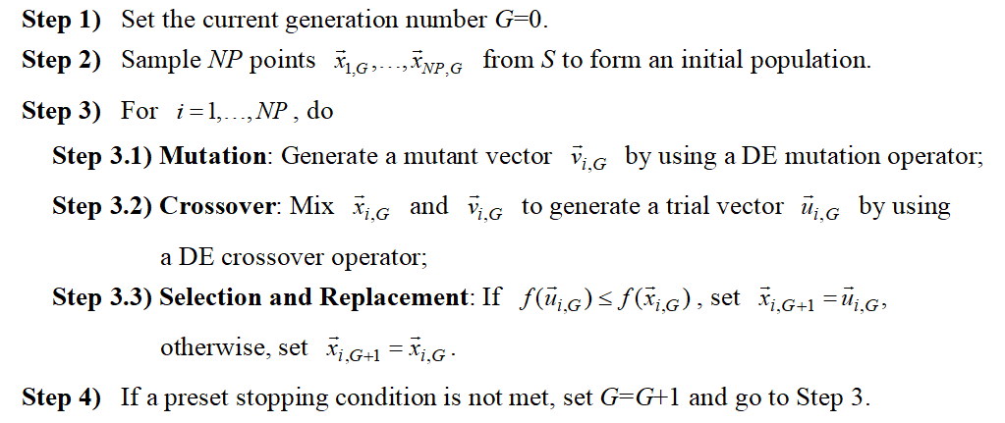
Differential Evolution (2/2)
The algorithmic framework of DE
the target vectors（目标向量）
Remark: mutation + crossover = trial vector generation strategy
（试验向量参数策略）

Slide 6




The Mutation Operators
the fashion the base vector has been selected
the number of the difference vector
the base vector
（基向量）
the scaling factor
（缩放因子）
rand/1
the difference vector
（差分向量）
rand/2
best/1
best/2
current-to-best/1
current-to-rand/1
Remark: r1, r2, r3, r4, and r5 are different indexes uniformly randomly selected from , is the best individual in the current population.
The scaling factor F plays a very important role in mutation.

Slide 7





The Crossover Operators (1/2)
Binomial crossover（二项式交叉）
the target vector
rand₁>CR
rand₂>CR
mix
the trial vector
the mutant vector
rand₁≤CR
rand₂≤CR
is always different from

Slide 8
The Crossover Operators (2/2)
Exponential crossover（指数交叉）
the target vector
mix
the trial vector
the mutant vector
P(r=v)=CR^{v-1}(1-CR)
The crossover control parameter（交叉控制参数） CR plays
a very important role in crossover.

Slide 9
DE Variants
By combining different mutation operators and different crossover operators, we can obtain different DE variants（变种）.
DE/x/y/z
  DE: differential evolution
  x: the fashion the base vector has been selected
  y: the number of the difference vector
  z: the type of the crossover operator. “bin” represents the binomial crossover and “exp” represents the exponential crossover
DE/rand/1/bin, DE/rand/1/exp, DE/rand/2/bin, …

Slide 10

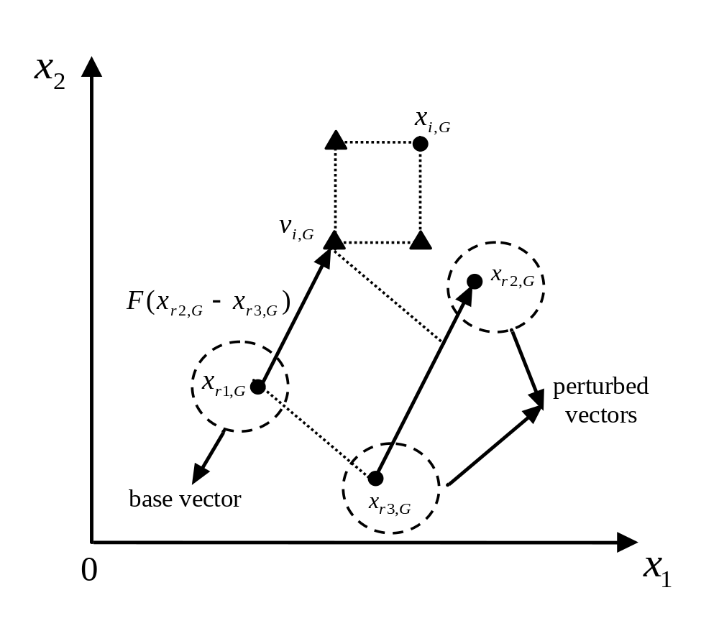
The Illustrative Graph of DE/rand/1/bin
the triangle denotes the trial vector

Slide 11
Outline of My Talk
Introduction to Differential Evolution
The Related Work
Composite Differential Evolution
Orthogonal Crossover based Differential Evolution
Conclusion

Slide 12
The Current Research Directions of DE
The DE performance mainly depends on two components
  trial vector generation strategy (i.e., the mutation and crossover operators)
  control parameters (i.e., the population size NP, the scaling factor F, and the crossover control parameter CR).
Much effort has been made to improve the performance of DE
  Introduction of new trial vector generation strategy for generating new solutions
  Tuning the control parameters (static/deterministic, dynamic/adaptive, and self-adaptive)
  Hybridization of DE with other operators or methods
  Use of multiple populations (distributed DE)

Slide 13
Six Representative DE
jDE (self-adaptive control parameters in DE, IEEE TEVC, 2006)
ODE (opposition-based DE, IEEE TEVC, 2008)
SaDE (DE with strategy adaptation, IEEE TEVC, 2009)
JADE (adaptive DE with optional external archive, IEEE TEVC, 2009)
SHADE (Success-history based parameter adaptation for DE, IEEE CEC2013, 2013)
L-SHADE (SHADE with linear population size reduction, IEEE CEC2014, 2014)

Slide 14
Outline of My Talk
Introduction to Differential Evolution
The Related Work
Composite Differential Evolution
Orthogonal Crossover based Differential Evolution
Conclusion

Slide 15

Composite Differential Evolution (CoDE)
Motivation（动机）
  During the last decade, DE researchers have suggested many empirical guidelines for choosing trial vector generation strategies and control parameter settings.
  However, these experiences have not yet systematically exploited in DE algorithm design.
whether the performance of DE can be improved by combining several effective trial vector generation strategies with some suitable control parameter settings

Slide 16

Composite Differential Evolution (CoDE)
Main idea（主要思想）
DE/rand/1/bin
F=1.0, CR=0.1
DE/rand/2/bin
F=1.0, CR=0.9
DE/current-to-rand/1
F=0.8, CR=0.2
strategy candidate pool
parameter candidate pool
Y. Wang, Z. Cai, and Q. Zhang, “Differential evolution with composite trial vector generation strategies and control parameters.” IEEE Transactions on Evolutionary Computation, vol. 15, no. 1, pp. 55-66, 2011.

Slide 17
Composite Differential Evolution (CoDE)
General guidelines for two candidate pools
  We expect that the chosen trial vector generation strategies and control parameter settings show distinct （相互不同）advantages.
  Thus, they can be effectively combined to solve different kinds of problems.

Slide 18
Composite Differential Evolution (CoDE)
Basic properties of the strategy candidate pool
  DE/rand/1/bin has stronger global exploration ability（全局开发能力）, and it is effective when solving multimodal problems.
  DE/rand/2/bin may lead to better permutation（扰动） than DE/rand/1/bin, since the former uses two difference vectors.
  DE/current-to-rand/1 is rotation-invariant（旋转不变） and suitable for rotated problems（旋转问题）.

Slide 19

Composite Differential Evolution (CoDE)
Basic properties of the parameter candidate pool
  A large value of F can increase the population diversity（群体多样性）.
  A low value of F can speed up the convergence（加速收敛）.
  A large value of CR can encourage the diversity of the offspring population（后代群体多样性）.
  A small value of CR can make each parameter being optimized independently（参数独立优化）.

Slide 20
Composite Differential Evolution (CoDE)
Basic properties of the parameter candidate pool
  When combined with the three strategies, [F=1.0,CR=0.1] is for dealing with separable problems（可分离问题）.
  [F=1.0,CR=0.9] is mainly to maintain the population diversity and to make the three strategies powerful in global exploration（全局开发）.
  [F=0.8,CR=0.2] encourages the exploitation（开采） of the three strategies in the search space and thus accelerates the convergence speed of the population.
Conclusion: the selected strategies and parameter settings exhibit distinct advantages and, therefore, they can complement one another for solving optimization problems of different characteristics.

Slide 21

Composite Differential Evolution (CoDE)
The main framework（主要框架）
the first trial vector
target vector
the second trial vector
the best trial vector
the third trial vector
combining each trial vector generation strategies with one control parameter setting randomly selected
comparison

Slide 22

Composite Differential Evolution (CoDE)
The experimental results
  25 test functions proposed in the IEEE CEC2005 were used to study the performance of the proposed CoDE
    unimodal functions F₁–F₅
    basic multimodal functions F₆–F₁₂
    expanded multimodal functions F₁₃–F₁₄
    hybrid composition functions F₁₅–F₂₅
  For each test function, 25 independent runs were conducted
  In each run, the function error value was recorded
  The average and standard deviation of the function error value in 25 runs were used for measuring the performance of each algorithm
  Wilcoxon’s rank sum test at a 0.05 significance level was adopted to compare different algorithms
the best solution found by the algorithm in a run
the global optimum of the test function

Slide 23
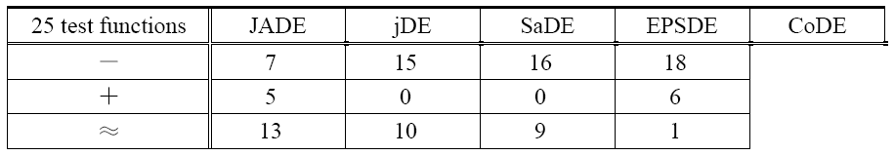
Composite Differential Evolution (CoDE)
The experimental results
  Comparison with four state-of-the-art DE
“－”, “＋”, and “≈” denote that the performance of the corresponding algorithm is worse than, better than, and similar to that of CoDE, respectively.
basic multimodal functions
expanded multimodal functions
hybrid composition functions
CoDE is the best
unimodal functions
CoDE is the second best
Overall, CoDE is better than the four competitors.

Slide 24
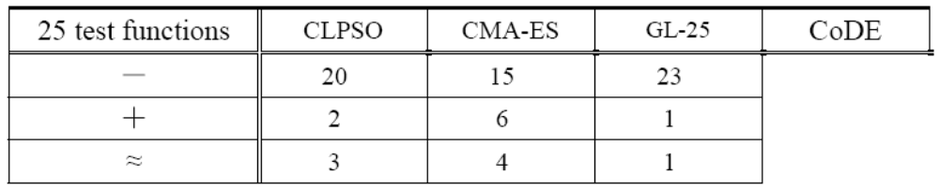
Composite Differential Evolution (CoDE)
The experimental results
  Comparison with CLPSO, CMA-ES, and GL-25
“－”, “＋”, and “≈” denote that the performance of the corresponding algorithm is worse than, better than, and similar to that of CoDE, respectively.
Overall, CoDE significantly outperforms CLPSO, CMA-ES, and GL-25.

Slide 25
Outline of My Talk
Introduction to Differential Evolution
The Related Work
Composite Differential Evolution
Orthogonal Crossover based Differential Evolution
Conclusion

Slide 26
Orthogonal Crossover based Differential Evolution
Motivation
  The crossover operators of DE can only generate a vertex（顶点） of a hyper-rectangle（超长方体） defined by the mutant and target vectors.
  Therefore, the search ability（搜索性能） of DE may be limited.
the triangle denotes the trial vector
whether the search ability of DE can be enhanced by effectively probing the hyper-rectangle defined by the mutant and target vectors

Slide 27
Orthogonal Crossover based Differential Evolution
Orthogonal design（正交设计）
  Orthogonal design is one of the experimental design methods（实验设计方法）
An example: the yield of a vegetable
 | Factors (K)
 | the temperature | the amount of fertilizer | the pH value of the soil
Levels (Q) | 20 ℃ | 100 g/m² | 6
 | 25 ℃ | 150 g/m² | 7
 | 30 ℃ | 200 g/m² | 8
The number of all the experiments is Q^{K}
the main aim of orthogonal design is to choose several representative（代表性） combinations

Slide 28
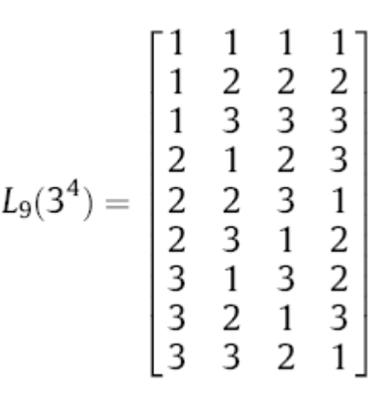
Orthogonal Crossover based Differential Evolution
How to implement the orthogonal design
  Orthogonal array: An orthogonal array for K factors with Q levels and M combinations is often denoted by L_{M}(Q^{K}).
  The orthogonality（正交性） of an orthogonal array means that:
    each level of the factor occurs the same number of times in each column
    each possible level combination of any two given factors occurs the same number of times in the array.
a level combination
a level
a factor

Slide 29
Orthogonal Crossover based Differential Evolution
Orthogonal crossover（正交交叉）
  The main idea
    In EAs, each individual in the population can be regarded as an experiment（实验）
    Crossover is a procedure for sampling several representative points (i.e., experiments) from a region defined by the parent solutions
    Orthogonal design can be used to make the crossover more statistically sound

Slide 30

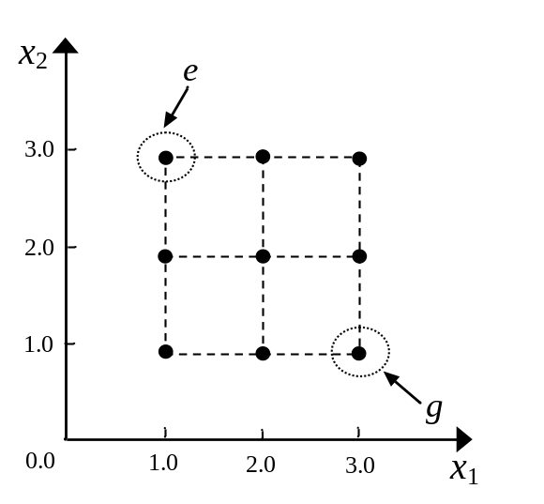

Orthogonal Crossover based Differential Evolution
Quantization orthogonal crossover (QOX，量化正交交叉)
  Step 1: quantize the solution space defined by two parents into a finite number of points
the number of variables
x₁
x₂
Q^{D}
[1.0, 3.0]
[1.0, 3.0]
(1.0, 2.0, 3.0)
(1.0, 2.0, 3.0)
the number of levels
Y. W. Leung and Y. Wang, “An orthogonal genetic algorithm with quantization for global numerical optimization,” IEEE Transactions on Evolutionary Computation, vol. 5, no. 1, pp. 41-53, 2001.

Slide 31






Orthogonal Crossover based Differential Evolution
Quantization orthogonal crossover (QOX)
  Step 2: select a small, but representative sample of points as the potential offspring by orthogonal design
    If D≤K, the first D columns of L_{M}(Q^{K}) can be used directly
    If D>K, the decision vector will be divided into K subvectors
x₁
x₂
x₃
x₄
x₅
x₆
x₁
x₂
D=2
K=4
2.0
3.0
4.0
3.0
4.0
5.0
2.0
5.0
8.0

Slide 32
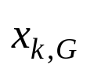
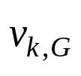


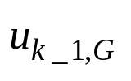
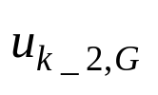



Orthogonal Crossover based Differential Evolution
We proposed a generic（通用） framework for using QOX in DE variants
comparison
L_{M}(Q^{K})
Remark: Our framework uses QOX to complement binomial crossover or exponential crossover for searching some promising regions in the search space.
Y. Wang, Z. Cai, and Q. Zhang, “Enhancing the search ability of differential evolution through orthogonal crossover,” Information Sciences, vol. 185, no. 1, pp. 153-177, 2012.

Slide 33
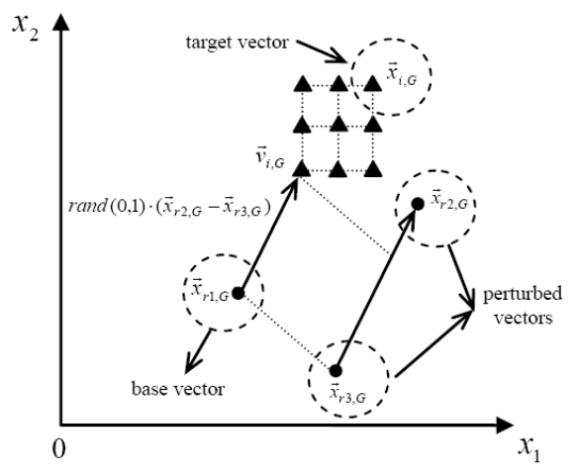
Orthogonal Crossover based Differential Evolution
An instantiation of our framework
  DE/rand/1/bin + QOX = OXDE
Our framework can be easily generalized to other DE variants by replacing DE/rand/1/bin with other DE variants.
an improvement

Slide 34
Orthogonal Crossover based Differential Evolution
The experimental results
  A suite of 24 test instances is used for our experimental studies
    the first 10 test instances are widely used in the evolutionary computation community
    the other 14 test instances are the first 14 test instances designed for the IEEE CEC2005
  Parameter settings
    NP=D=30, F=0.9, CR=0.9, and FES_{max}= 10,000×D
  The average and standard deviation of the function error value were recorded for measuring the performance of each algorithm
  For each test function, 50 independent runs were conducted
  The t-test at a 0.05 significance level has been used in comparison

Slide 35


Orthogonal Crossover based Differential Evolution
The experimental results
  How to measure the successful run
    A run is successful if
    The parameter is set to 10⁻² for test functions F₆-F₁₄, and 10⁻⁶ for the rest of the test functions
  How to measure the convergence speed
    The mean and standard derivation of FES_{s} among 50 independent runs are used to measure the convergence speed of an algorithm
successful condition
    In a successful run, FES_{s} is the number of fitness evaluations needed for reaching successful condition
    In an unsuccessful run, FES_{s} is set to FES_{max}

Slide 36
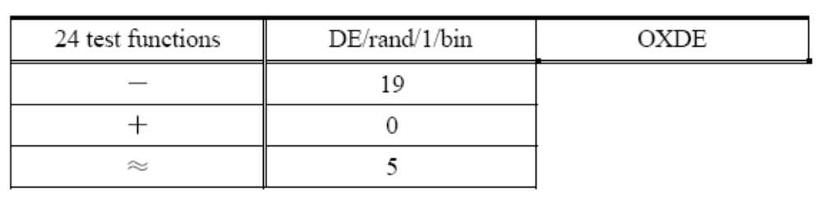
Orthogonal Crossover based Differential Evolution
The experimental results
  OXDE VS DE/rand/1/bin
    OXDE can achieve at least one successful run on 11 test functions
    DE/rand/1/bin can achieve at least one successful run on 7 test functions
    OXDE has a faster convergence speed on these 11 test instances.
“－”, “＋”, and “≈” denote that the performance of the corresponding algorithm is worse than, better than, and similar to that of OXDE, respectively.
OXDE certainly outperforms DE/rand/1/bin in terms of both the solution quality and the convergence speed.

Slide 37
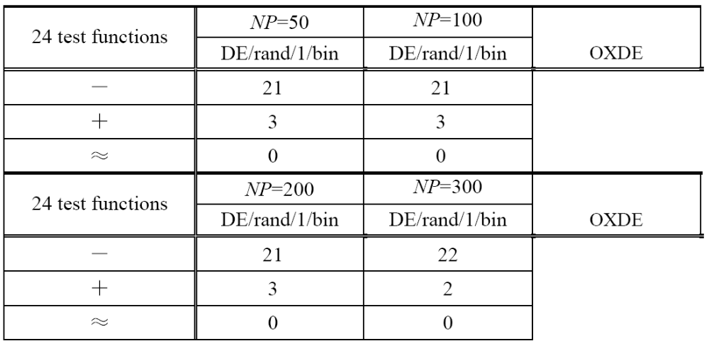
Orthogonal Crossover based Differential Evolution
The experimental results
  OXDE VS DE/rand/1/bin
    Effect of population size (NP=50, 100, 200, and 300)
“－”, “＋”, and “≈” denote that the performance of the corresponding algorithm is worse than, better than, and similar to that of OXDE, respectively.
OXDE performs significantly better than DE/rand/1/bin with different population sizes.

Slide 38
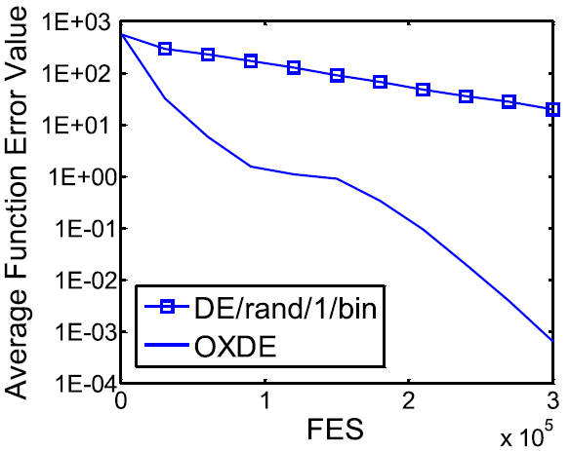
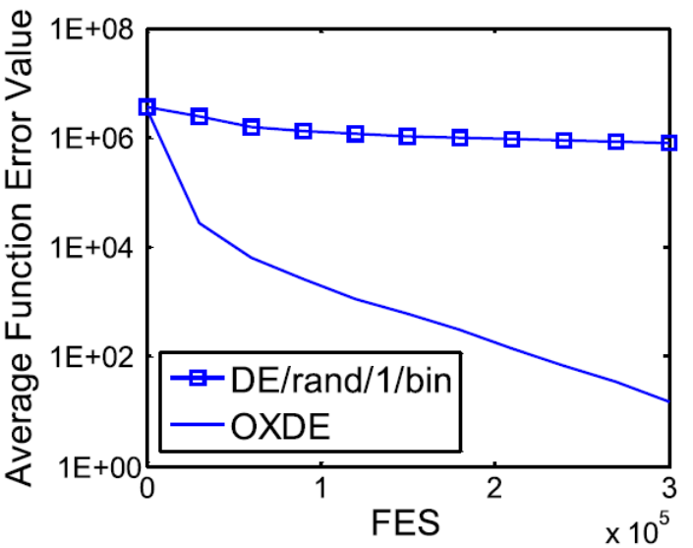
Orthogonal Crossover based Differential Evolution
The experimental results
  OXDE VS DE/rand/1/bin
    Effect of population size (NP=50, 100, 200, and 300)
F_{grw} (NP=100)
F₅ (NP=200)

Slide 39
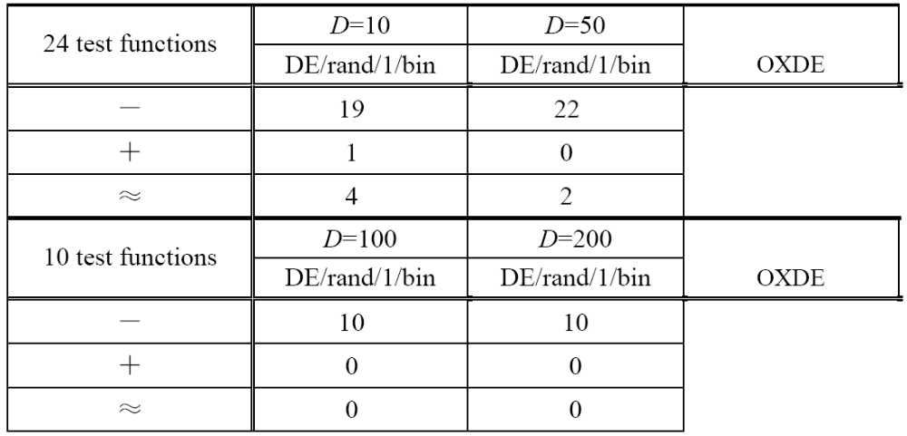
Orthogonal Crossover based Differential Evolution
The experimental results
  OXDE VS DE/rand/1/bin
    Effect of the number of variables (D=10, 50, 100, and 200)
“－”, “＋”, and “≈” denote that the performance of the corresponding algorithm is worse than, better than, and similar to that of OXDE, respectively.
The advantage of OXDE over DE/rand/1/bin increases as the number of variables increases.

Slide 40
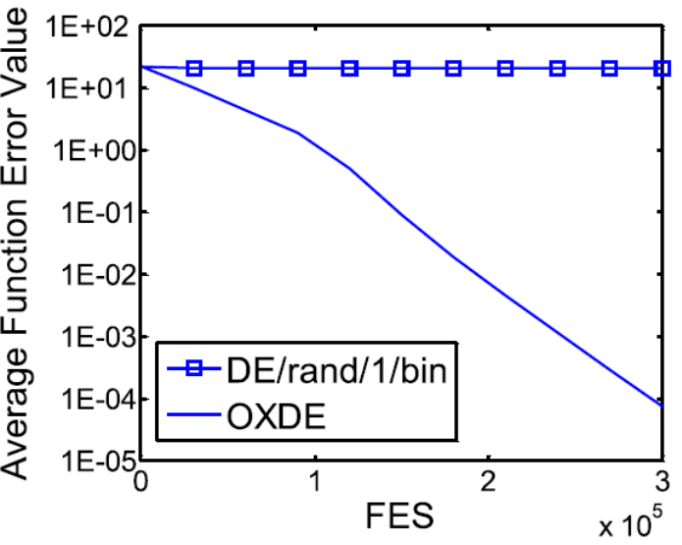
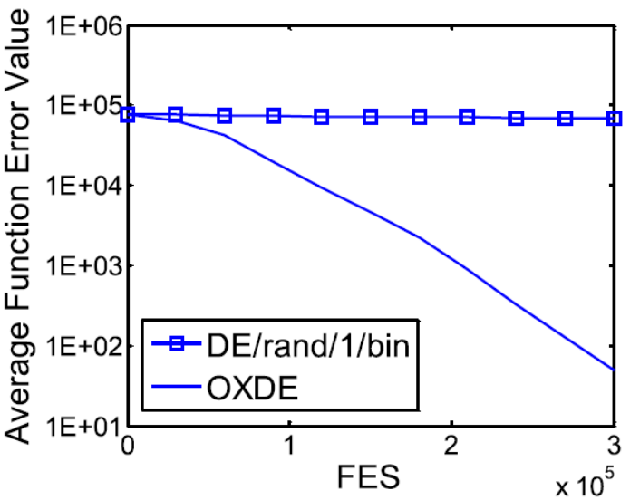
Orthogonal Crossover based Differential Evolution
The experimental results
  OXDE VS DE/rand/1/bin
    Effect of the number of variables (D=10, 50, 100, and 200)
F_{ack} (D=100)
F_{sch} (D=200)

Slide 41
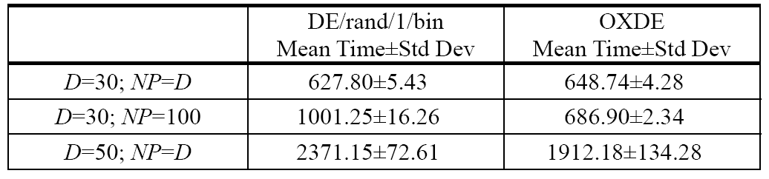
Orthogonal Crossover based Differential Evolution
The experimental results
  Runtime complexity of OXDE

Slide 42
Orthogonal Crossover based Differential Evolution
The experimental results
  Can our framework improve other DE variants?
    Our framework can greatly improve the performance of DEahcSPX, DE/rand/1/exp, DE/rand/2/exp, and DE/rand/2/bin
    Our framework can also improve the performance of jDE, SaDE, and JADE to a certain degree
our framework could be an effective way to improve the performance of other DE variants.

Slide 43
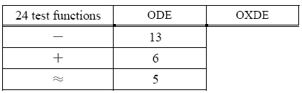
Orthogonal Crossover based Differential Evolution
The experimental results
  Comparison with opposition-based DE (ODE)
“－”, “＋”, and “≈” denote that the performance of the corresponding algorithm is worse than, better than, and similar to that of OXDE, respectively.
OXDE performs better than ODE.

Slide 44
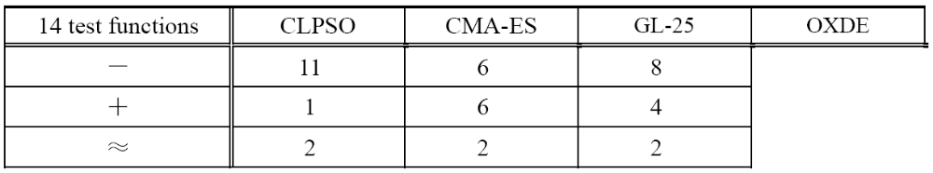
Orthogonal Crossover based Differential Evolution
The experimental results
  Comparison with other state-of-the-art EAs
“－”, “＋”, and “≈” denote that the performance of the corresponding algorithm is worse than, better than, and similar to that of OXDE, respectively.
OXDE is a generally good global function optimizer.

Slide 45
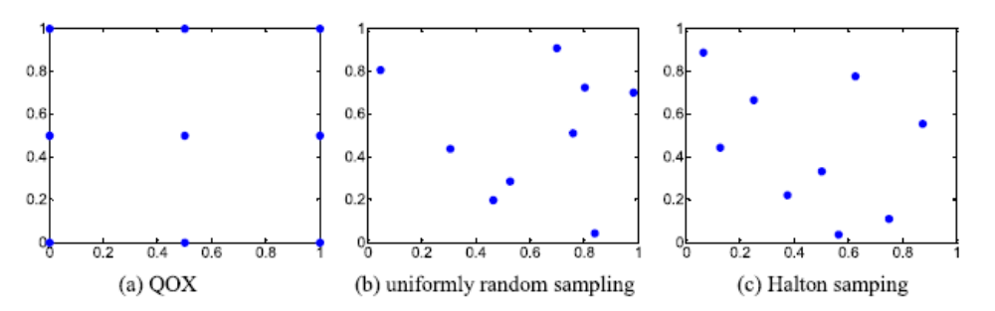
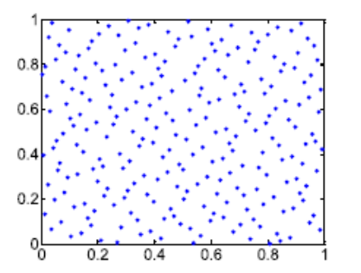
Orthogonal Crossover based Differential Evolution
The experimental results
  Orthogonal crossover VS uniformly random sampling and Halton sampling
Uniformly random sampling + DE = URSDE
Halton sampling + DE = HSDE
OXDE is able to exhibit better performance than HSDE in nearly all test instances
URSDE shows better performance than OXDE in four test instances
OXDE outperforms URSDE in eight test instances
the same level of improvement cannot be achieved via additional sampling strategies

Slide 46
Outline of My Talk
Introduction to Differential Evolution
The Related Work
Composite Differential Evolution
Orthogonal Crossover based Differential Evolution
Conclusion

Slide 47
Conclusion
We have demonstrated that the experiences and knowledge obtained from the researchers can be exploited to improve the performance of DE significantly.
We have verified that the search ability of DE can be enhanced by effectively probing the hyper-rectangle defined by the mutant and target vectors.

Slide 48
Occam's Razor
Entities should not be multiplied unnecessarily.
--William of Occam

Slide 49


